Slide 1
Structure Programming
ICT-1105
Information and Communication Technology
Lecture-14
Date:

Slide 2
Class contents has given in Google Classroom with code
nhauiw4

Slide 3
Functions

Slide 4
MONOLITHIC VS MODULAR PROGRAMMING
1. Monolithic Programming indicates the program which contains a single function for the large program.
2. Modular programming help the programmer to divide the whole program into different modules and each module is separately developed and tested. Then the linker will link all these modules to form the complete program.
3. On the other hand monolithic programming will not divide the program and it is a single thread of execution. When the program size increases it leads inconvenience and difficult to maintain.

Slide 5
MONOLITHIC VS MODULAR PROGRAMMING
Disadvantages of monolithic programming:
Difficult to check error on large programs.
Difficult to maintain.
Code can be specific to a particular problem. i.e. it can not be reused.

Slide 6
MONOLITHIC VS MODULAR PROGRAMMING
Advantage of modular programming:
Modular program are easier to code and debug.
Reduces the programming size.
Code can be reused in other programs.
Problem can be isolated to specific module so easier to find the error and correct it.

Slide 7
Function : Definition
A function is a block of code/group of statements/self contained block of statements/ basic building blocks in a program that performs a particular task.
It is also known as procedure or subroutine or module, in other programming languages.

Slide 8
Function : Definition
To perform any task, we can create function. A function can be called many times. It provides modularity and code reusability.

Slide 9
Advantage of functions
1) Code Reusability
By creating functions in C, you can call it many times. So we don't need to write the same code again and again.
2) Code optimization
It makes the code optimized we don't need to write much code.

Slide 10
Advantage of functions
3) Easily to debug the program.
Example:
Suppose, you have to check 3 numbers (781, 883 and 531) whether it is prime number or not. Without using function, you need to write the prime number logic 3 times. So, there is repetition of code.
But if you use functions, you need to write the logic only once and you can reuse it several times.

Slide 11
Types of Functions
There are two types of functions in C programming:
1. Library Functions
2. User-defined functions

Slide 12
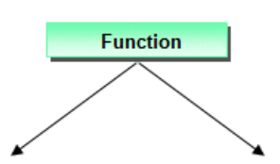
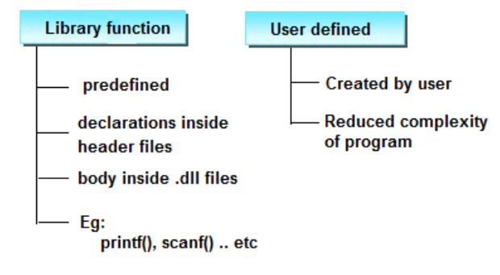
Types of Functions

Slide 13
Types of Functions
1. C Standard Library Functions: are the functions which are declared in the C header files such as scanf(), printf(), gets(), puts(), ceil(), floor() etc. You just need to include appropriate header files to use these functions. These are already declared and defined in C libraries.

Slide 14
Types of Functions
2. User-defined functions: are the functions which are created by the C programmer, so that he/she can use it many times. It reduces complexity of a big program and optimizes the code. Depending upon the complexity and requirement of the program, you can create as many user-defined functions as you want.

Slide 15
Types of Functions
A function that is declare, calling and define by the user is called user define function. Every user define function has three parts as:
1. Prototype or Declaration
2. Calling
3. Definition

Slide 16
Elements of User defined Functions
In order to write an efficient user defined function, the programmer must familiar with the following three elements.
1 : Function Declaration
(Function Prototype)
2 : Function Call
3 : Function Definition

Slide 17
Function Declaration (Function Prototype)
1. It is also known as function prototype .
2. It inform the computer about the three things
a) Name of the function
b) Number and type of arguments received by the function.
c) Type of value return by the function

Slide 18
Function Declaration (Function Prototype)
A function declaration is the process of tells the compiler about a function name.
Syntax
return_type function_name(parameter/argument);
return_type function-name();
Ex : int add (int a,int b);
int add();
Note: At the time of function declaration function must be terminated with ;.

Slide 19
Function Declaration (Function Prototype)
3. Calling function need information about called function .If called function is place before calling function then the declaration is not needed.

Slide 20
Calling a function/function call
When we call any function control goes to function body and execute entire code.
Syntax :
function-name();
function-name(parameter/argument);
return value/ variable = function-name(parameter/argument);
Ex :
add(); // function without parameter/argument
add(a,b); // function with parameter/argument
c=fun(a,b); // function with parameter/argument and return values

Slide 21
Defining a function
Defining of function is nothing but give body of function that means write logic inside function body.
1. It consists of code description and code of a function .
It consists of two parts
a) Function header
b) Function coding

Slide 22
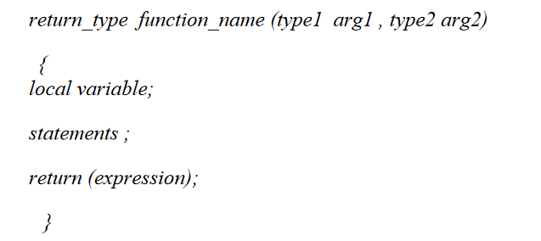
Defining a function
Syntax:

Slide 23
Defining a function
2. Function definition can be placed any where in the program but generally placed after the main function .
3. Local variable declared inside the function is local to that function. It cannot be used anywhere
in the program and its existence is only within the function.
4. Function definition cannot be nested.
5. Return type denote the type of value that function will return and return type is optional if omitted it is assumed to be integer by default.

Slide 24
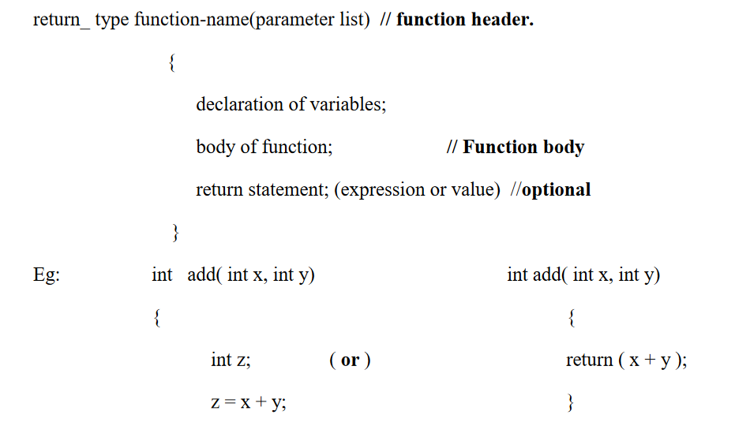
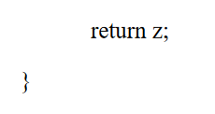
Defining a function

Slide 25
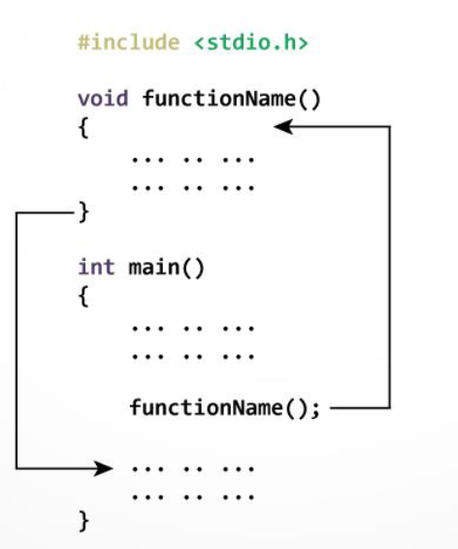
How functions work in C programming

Slide 26
How functions work in C programming
The execution of a C program begins from the main() function.
When the compiler encounters functionName(); inside the main function, control of the program
jumps to void functionName() And, the compiler starts executing the codes inside the user-defined function. The control of the program jumps to statement next to functionName(); once all the codes inside the function definition are executed.

Slide 27
Example-1
#include<stdio.h>
void sum(); // declaring a function
int a=10,b=20, c;
void sum() // defining function
{
c=a+b;
printf("Sum: %d", c);
}

Slide 28
Example-1
void main()
{
sum(); // calling function
}
Output :??

Slide 29
Example-2
#include <stdio.h>
int addNumbers(int a, int b); // function prototype
int main()
{
int n1,n2,sum;
printf("Enters two numbers: ");
scanf("%d %d",&n1,&n2);
sum = addNumbers(n1, n2); // function call

Slide 30
Example-2
printf("sum = %d",sum);
return 0;
}
int addNumbers(int a,int b) // function definition
{
int result;
result = a+b;
return result; // return statement
}

Slide 31
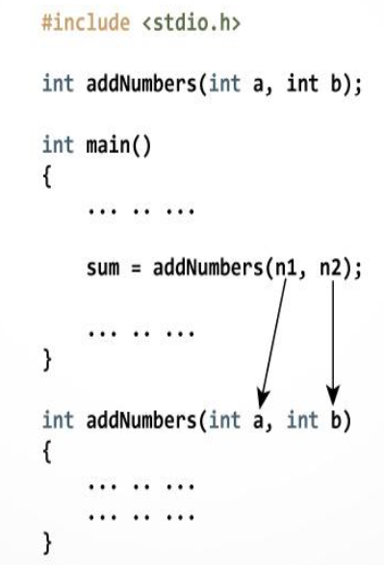
How to pass arguments to a function?

Slide 32
Return Statement
Syntax of return statement
Syntax : return; // does not return any value
or
return(exp); // the specified exp value to calling function.

Slide 33
Return Statement
For example,
return a;
return (a+b);
The return statement terminates the execution of a function and returns a value to the calling function. The program control is transferred to the calling function after return statement.
In previous example, the value of variable result is returned to the variable sum in the main() function.

Slide 34
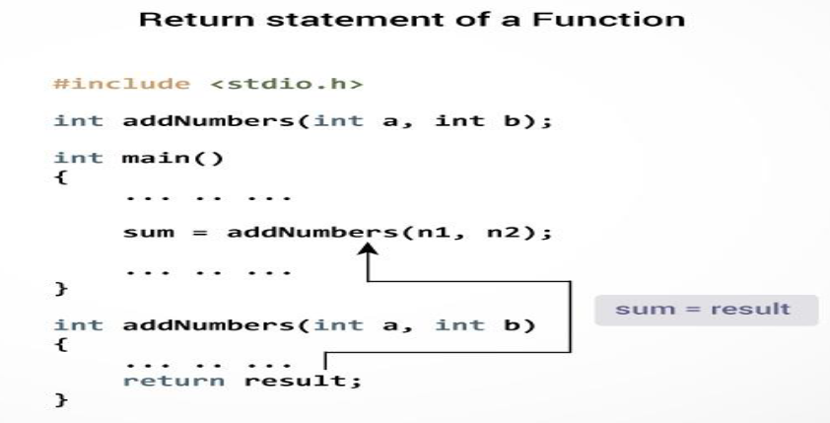
Return Statement

Slide 35
Thank you….

